Slide 1
Chapter 16
Money and Banking

Slide 2

Why do we need money?
To exchange for those goods and services we each need and want but are unable to produce for ourselves, because
we are not self-sufficient (individually we cannot produce everything we need and want)
we specialise in those tasks and productive activities we are best able to do and therefore need to trade with producers of other products

Slide 3
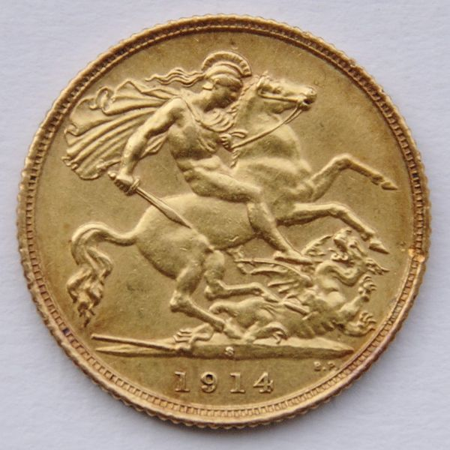
What is “money”?
Money is any object or record that is generally accepted as payment for goods and services and repayment of debts in a given country or economy.
Money originated as commodity money (eg gold or silver),
modern money systems are based on fiat money.
Fiat money is money that has value because everyone agrees that it does.
The term derives from the Latin fiat, meaning "let it be done" or "it shall be [money]", as such money is established by government decree.

Slide 4

Believed to be the first universal form of money
Portable/durable/divisible/easily recognized/
250 species only one native from Maldives used
India/China 7th century to 11th century/Southeast Asia/Middle east and Africa used in slave trade up to 18 century copper coins replaced them

Slide 5

Money
During World War II, cigarettes were used as money in some prisoner-of-war camps.

Slide 6
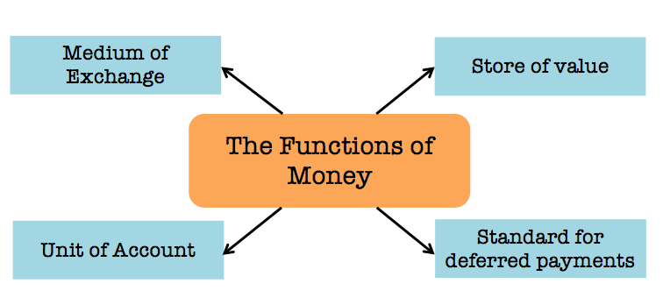



To overcome the problems of barter a money must be:
IOU $20
Prices

Slide 7
Characteristics of money is important and so is the functions of money

Slide 8
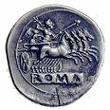
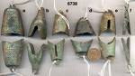
Durability
Durability means that the item must be able to withstand being used repeatedly.
Items that are considered Currency, coins and paper bills used as money meet this requirement.
Portability
Portability means that individuals are able to carry money with them and transfer it easily to other individuals.
This is why coins and paper money have historically proved popular.

Slide 9
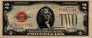
Uniformity
Uniformity means that all versions of the same denomination of currency has same value .
Acceptability
Acceptability means that everyone must be able to use the money for transactions.
In the United States this is indicated on paper bills by the notation: “This note is legal tender for all debts, public and private”.

Slide 10
Characteristics of money
Divisibility | Scarcity | Stability of supply | Stable value
Divided into smaller denominations . | If to there are too many it would be worthless | Needs to be stable production for lone period of time | Value needs to maintained for a period of time

Slide 11
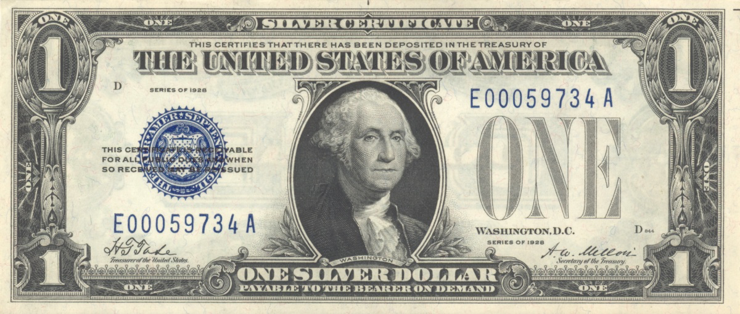
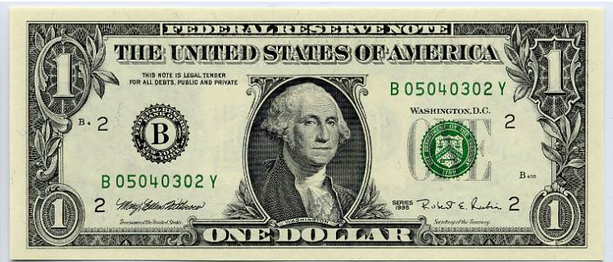

Slide 12

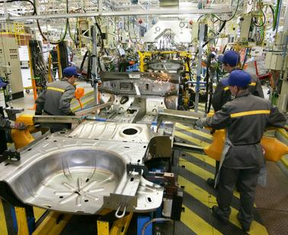

Financing economic activity
Banks lend money to people, firms and government organizations to finance their spending
Stock can be sold on the stock market to provide long-term finance for companies and governments
Banks are financial intermediaries: they bring together customers who want to save their money with customers who want to borrow it

Slide 13
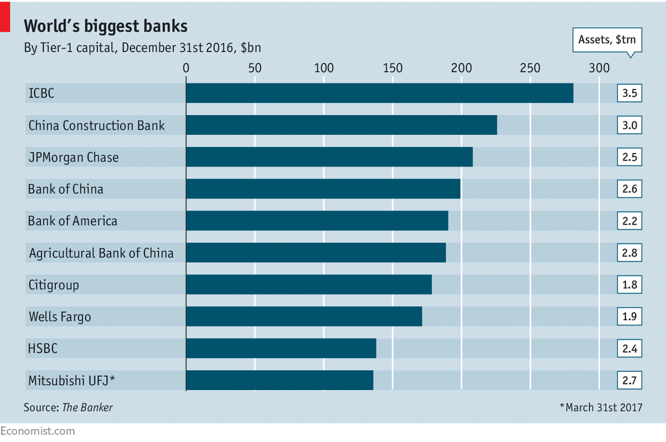
The role of a commercial bank
A commercial bank is a retail bank that provides financial services to its customers, such as accepting savings deposits and approving bank loans.
Aim of commercial bank;
Profit for shareholders ( by giving loans out)
Liquidity is turning assets into cash.
Banks must be able to ensure that customers can withdraw there money from their accounts.
Liquidity for banks is a measure of the cash and other assets banks have available to quickly pay bills and meet short-term business and financial obligations.
Thus must balance between liquidity & profitability e.g not loan out all the deposits.
Notes:
All commercial banks are responsible for maintaining the deposits of their account holders.
Transactions are socially and legally governed by the central bank.
Commercial banking started over 200 years ago when goldsmiths (metal workers specialising in precious metals such as gold) operated as banks.
Banking itselfcan be traced as fur back as 2000 BC when merchants in Assyria and Babylonia used grain Joans to farmers and other traders. Modern commercial banking using the internet (c-banking) did not start until 1995.

Slide 14
The functions of commercial banks can be split into two categories: primary and secondary functions.
The primary functions of commercial banks include the following:
Accepting deposits
including private individuals, businesses and governments. Current account little interest & and time deposits
Making advances
Commercial banks provide advances (loans) to their customers. Overdrafts & mortgages
What is an overdraft?
A bank overdraft is a line of credit that covers your transactions if your bank account balance drops below zero.
Cannot be used for large borrowing
Rates of interest higher than loans Bank can change limit at any time or ask for money to be paid back sooner than expected
What is a Mortgage ?
Mortgages are “secured” loans.
With a secured loan, the borrower promises collateral to the lender in the event that they stop making payments.
In the case of a mortgage, the collateral is the home.
If you stop making payments on your mortgage, your lender can take possession of your home, in a process known as foreclosure.
There are credit checks of people taking out the loan
For Firms checking of firms accounts & business plans
Notes:
Credit creation
Banks increase the supply of money in an economy by making money available to borrowers.
Credit allows the borrower to gain purchasing power (money) now with the promise to pay the lender (or creditor) at a future time.
Credit creation enables commercial banks to generate considerable additional purchasing power from their cash deposits.
Central banks can print money, they do not create credit;
this is a key function that distinguishes commercial banks from other financial institutions, such as insurance companies and investment banks.

Slide 15
The role of a commercial bank secondary functions (or general utility functions) of commercial banks include:
• collecting and clearing cheques on behalf of their clients
• offering additional financial services, such as tax advice, foreign exchange dealings
and the buying and selling of shares
• providing safety deposit boxes
• providing money transfer facilities, such as transferring money to an overseas
bank account or paying various bills, such as telephone, electricity, gas and
water bills
• providing credit card facilities both private individuals and commercial clients
• providing internet banking facilities, such as online bill payments, online bank
Transfers

Slide 16
What is 'Islamic Banking'
Islamic banking is a banking system that is based on the principles of Islamic law, also referred to as Shariah law, and guided by Islamic economics.
Two basic principles behind Islamic banking are
sharing of profit and loss and,
prohibition of the collection and payment of interest by lenders and investors. Collecting interest or "riga" is not permitted under Islamic law.
For example, in 1963, Egyptians formed an Islamic bank in Mit Ghmar. When the bank loaned money to businesses, it did so on a profit-sharing model. To reduce risk, the bank only approved about 40% of its business loan applications, but the default ratio was zero.

Slide 17

The role of a central bank
The central bank is at the centre of the banking system in most economies
The main function of a central bank is to maintain the stability of the national currency and the money supply
THE BANKERS’ BANK
Supervises the banking system and regulates the conduct of banks
Holds the accounts of banks and transfers money between them (Clearing system)
Is lender of the last resort to banks if they run short of money (ensures bank does not collapse protects jobs and safeguards nations banking system)
The Bank of England

Slide 18
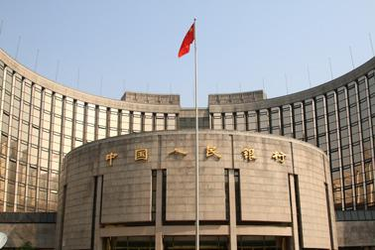
The role of a central bank
THE GOVERNMENT’S BANK
Issues notes and coins
Manages the national debt (borrowing) (Bonds)
Manages payments to and from the government (like a commercial bank)
Manages the nation’s gold reserves
Foreign currency reserves (Stabilising FX)
Operates the government’s monetary policy : Keep inflation low & steady by controlling the money supply and thus interest rates.
If need to reduce inflation Central bank will increase IR leading to increases in loan repayments and thus less disposable income
The Central Bank of China

Slide 19

Independence of central bank
Governments tend to make poor decisions about monetary policy. In particular, they tended to be influenced by short-term political considerations.
Before an election, the temptation is for a government to cut interest rates, making boom and bust economic cycles more likely. Therefore arguably, it is better to take monetary policy out of the government’s hands.
An independent Central Bank may have more credibility. If people have more confidence in the Central Bank, this helps to reduce inflationary expectations. In turn, this makes inflation easier to keep low.
The Federal reserve

